Slide 1


WEATHER monitoring system
Members
SANKALP THORAT (124CS0049)
ANIKET PATIL(124AD0042)
SAHITHI(524CS0013)
NEELIMA(124CS0058)

Slide 2

Introduction
The primary objective of this project is to analyze temperature and rainfall data collected from different cities over a one-year period. The project is designed to be user-friendly and interactive, incorporating games to make the analysis process more enjoyable.
The project facilitates the performance of various analyses on temperature data recorded in the previous year. These analyses include:
Calculating statistical measures (e.g., mean, median, standard deviation)
Visualizing data trends and patterns
Identifying correlations between temperature and rainfall
Predicting future temperature patterns

Slide 3
This program is entirely written in the C programming language. It leverages several standard libraries such as stdio.h (standard input/output), string.h (string manipulation), windows.h (Windows-specific functions), stdlib.h (standard library), and time.h (time manipulation).
The program demonstrates various programming concepts, including:
Function definitions and calls
Pointer usage for memory management
Iterative control flow with for and while loops
String operations, such as string comparison
Array data structures for storing collections of elements(2D,3D)
Sorting algorithms, specifically the bubble sort technique

Slide 4
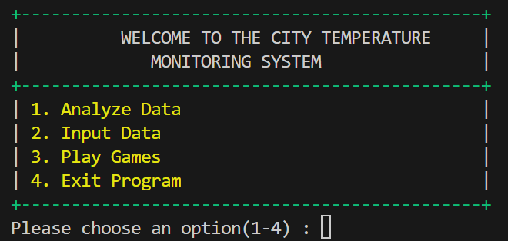
The program offers a comprehensive suite of functions for analyzing temperature and rainfall data. Key features include:
Temperature Analysis:
  Calculation of maximum, minimum, and average temperatures for a given year
  Identification of days with extreme temperatures (cold and hot)
  Graphical representation of monthly temperature trends
  Analysis of temperature trends, deviations, and streaks
  Temperature data categorization based on specific criteria
  Temperature unit conversion (e.g., Celsius to Fahrenheit)
  Temprature prediction system.
Seasonal Analysis:
  Analysis of seasonal temperature patterns and variations
Rainfall Data Analysis:
  Analysis of rainfall patterns and trends
User Interaction:
  User-friendly input interface for data entry
  Interactive games to enhance user engagement
Data Storage:
  3D arrays to store data for multiple cities

Slide 5

Thank You!
Team Members
SANKALP THORAT (124CS0049)
ANIKET PATIL(124AD0042)
SAHITHI(524CS0013)
NEELIMA(124CS0058)

